Slide 1
Reconstructing the Amino Acid Scoring Matrices to
Improve Homology Detection in Intrinsically Disordered
Proteins
Student: Feng-Yang Tsai (蔡豐仰)
Advisor: Prof. Chang-Biau Yang (楊昌彪)
Date: Sept. 3, 2020

Slide 2
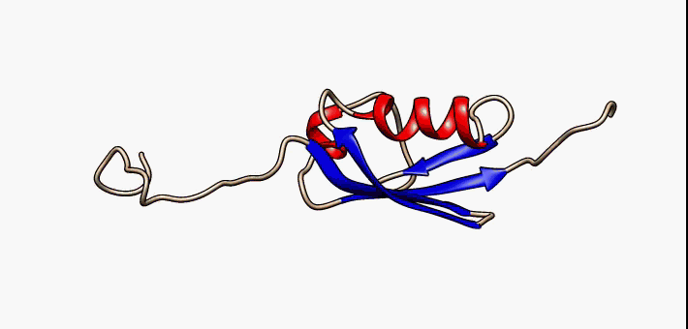
Intrinsically Disordered Proteins (IDPs)
Intrinsically disordered proteins (IDPs) :
● not attain stable three-dimensional structures.
● appear unfolded.
Interactive version of figure from: Majorek, Karolina; Kozlowski, Lukasz; Jakalski, Marcin; Bujnicki Janusz M. (2008) First Steps of Protein Structure Prediction. In: Prediction of Protein Structures, Functions, and Interactions Pages: 39-62.
Notes:
固有非結構蛋白
帕金森氏症
阿茲海默症

Slide 3
Intrinsically Disordered Proteins (IDPs)
Uversky in 2013 calculated the amino acid composition of disordered regions in DisProt and PDB.
● order-promoting residues
(H, M, W, C, F, I, Y, V, L and N)
● disorder-promoting residues
(A, G, Q, S, P, E and K)
Vladimir N Uversky, The alphabet of intrinsic disorder II. Various roles of glutamic acid in ordered and intrinsically disordered proteins, Intrinsically Disord Proteins. 1(1): 1-23, 2013.
Notes:
SwissProt 51 (Bairoch et al., 2005), closest to the distribution of amino acids in nature among the four datasets
DisProt 3.4, comprised of a set of consensus sequences of experimentally determined disordered regions (Sickmeier et al., 2007)
Fractional difference in the amino acid composition (compositional profile) between the typical IDPs from the DisProt database⁴⁹ and a set of completely ordered proteins⁵⁰ calculated for each amino acid residue. The fractional difference was evaluated as (C_{DisProt}-C_{PDB})/C_{PDB}, where C_{DisProt} is the content of a given amino acid in a DisProt databse, and C_{PDB} is the corresponding content in the data set of fully ordered proteins. Positive bars correspond to residues found more abundantly in IDPs, whereas negative bars show residues, in which IDPs are depleted. Amino acid types were ranked according to their decreasing disorder-promoting potential

Slide 4
Smith-Waterman Algorithm:
e.g.
S
V
E
T
D
A = TSVNQET
B = SVETD
0
0
0
0
0
0
T
0
1
0
0
5
0
S
0
4
0
0
1
5
V
0
0
8
2
1
0
N
0
1
2
8
1
2
Q
0
0
1
4
7
1
E
0
0
0
6
3
7
T
0
1
1
0
11
5
  ● Gap opening penalty: -5
  ● Gap extension penalty: -1
S V - - E T
| | - - | |
S V N Q E T
BLOSUM62 scoring matrix
Notes:
一個適合的scoring matrix 就會影響到如何找到alignment分數
為何不用global
想像一下A序列只有10個長度
B序列有50個長度

Slide 5
An Example of the SCOP Hierarchy
SCOP
Root
Determined by structure
α
β
α/β
c
α+β
Class
Rossmann fold
Flavodoxin-like
ΤΙΜ α/β-Barrel
c.1
Fold
TIM
Trp biosynthesis
Aldolase
c.1.10
RuBisCo (C)
Superfamily
Class I aldolase
Class II FBP aldolase
…
GatZ-like
Family
(7 families)
c.1.10.1
c.1.10.7
Putative tagatose 6-phosphate kinase 1 GatZ
Protein
磷酸激酶
Escherichia coli
大腸桿菌
Species
Related by homology
2fiq
PDB/Ref
Fox NK, Brenner SE, Chandonia JM. 2014. SCOPe: Structural Classification of Proteins—extended, integrating SCOP and ASTRAL data and classification of new structures. Nucleic Acids Research 42:D304-309.
Notes:
磷酸激酶

Slide 6

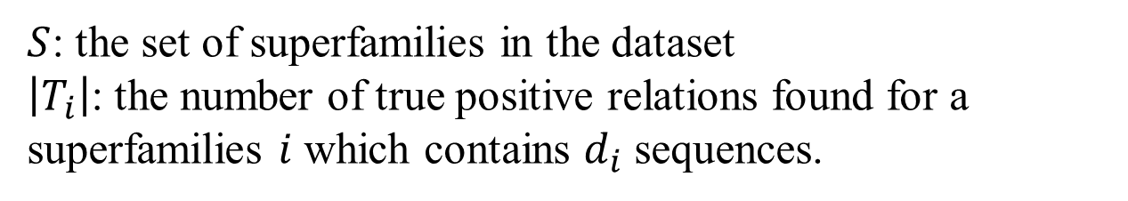
Calculating Fitness and Evaluation
$Q_{ }=\frac{1}{\left|S\right|}\sum_{i=1}^{\left|S\right|}{\frac{\left|T_{i}\right|}{2\left(\begin{matrix}d_{i} \\ 2\end{matrix}\right)}}$
$S$: the set of superfamilies in the dataset
$\left|T_{i}\right|$: the number of true positive relations found for a superfamilies $i$ which contains $d_{i}$ sequences.

Slide 7
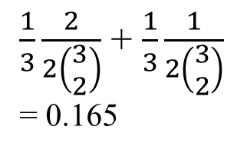
Calculating Fitness and Evaluation
Database search results |  |  | Analysis
Query | Target | E-value | Related? | Coverage | Errors per query
Q7Z2Z1 c.1.10.1 | Q8BQ33 c.1.10.2 | 3.3e-35 | Yes | 0.055 | 0
Q7Z2Z1 c.1.10.1 | D3IUT5 c.1.10.3 | 3.3e-24 | Yes | 0.110 | 0
Q13009 c.1.699.2 | Q63406 c.1.10.1 | 1.6e-20 | No | 0.11 | 0.001
Q13009 c.1.699.2 | P38990 c.1.699.4 | 5e-19 | Yes | 0.165 | 0.001
●●●
Q70E73 c.1.532.1 | Q63406 a.1.1881.1 | 1.6e-2 | No | 0.385 | 0.010
Superfamily c.1.10:
(3 sequences)
Superfamily c.1.699:
(3 sequences)
Superfamily c.1.532:
(3 sequences)
$\frac{1}{3}\frac{2}{2\left(\begin{matrix}3 \\ 2\end{matrix}\right)}$ + $\frac{1}{3}\frac{1}{2\left(\begin{matrix}3 \\ 2\end{matrix}\right)}$
= 0.165
We employed SSEARCH from FASTA package (Version: 36.10) to evaluate the utility value of our matrices with respect to various commonly used search matrices.

Slide 8
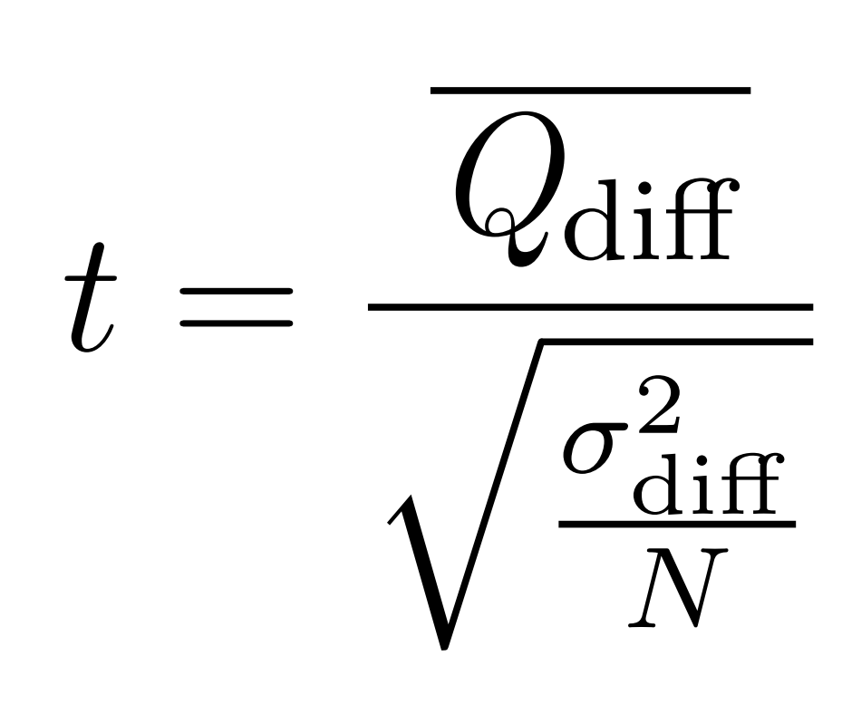

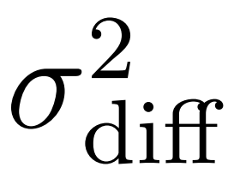
Signiﬁcant Test with Student’s t-test:
where and are the mean and the variance of coverages diﬀerence with 0.01 EPQ for the pair of matrices.
Notes:
前側與後側

Slide 9
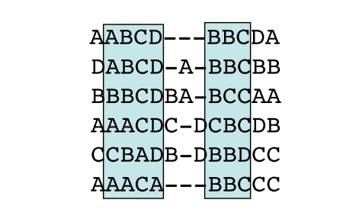
The Blocks Database:
• Henikoff (1991) developed a database of “blocks”based on sequences with shared motifs (>2,000 blocks of aligned sequence segments from >500 groups of related proteins)
• The Blocks Database contains multiple alignments of conserved regions in protein families.

Slide 10
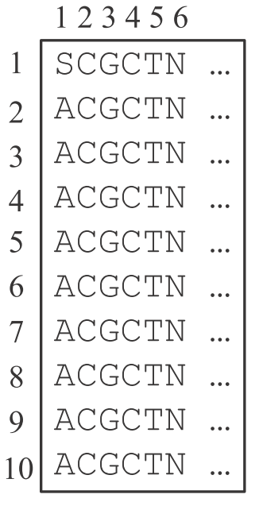
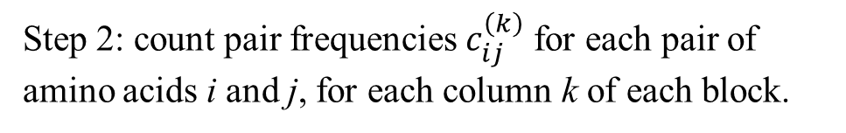
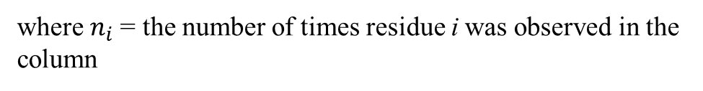

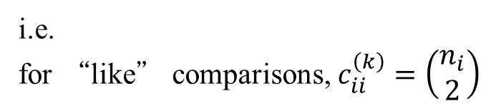
Example of BLOSUM Calculation
Step 2: count pair frequencies${ c}_{ij}^{\left(k\right)}$ for each pair of amino acids i and j, for each column k of each block.
Pair |  | Frequency of occurrence
AA |  | 36
AS | SA | 9
i.e.
for “like” comparisons, $c_{ii}^{\left(k\right)}=\left(\begin{matrix}n_{i} \\ 2\end{matrix}\right)$
for “unlike” comparisons, $c_{ij}^{\left(k\right)}= n_{i}n_{j}$
where $n_{i}$= the number of times residue i was observed in the column

Slide 11
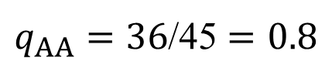
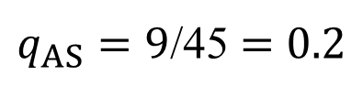
Example of BLOSUM Calculation
Step 3: count the observed and expected frequency of amino acid pairs.
Pair |  | Frequency of occurrence
AA |  | 36
AS | SA | 9
$q_{AA}=36$/45 $=0.8$
$q_{AS}=9$/45 $=$ $0.2$

Slide 12
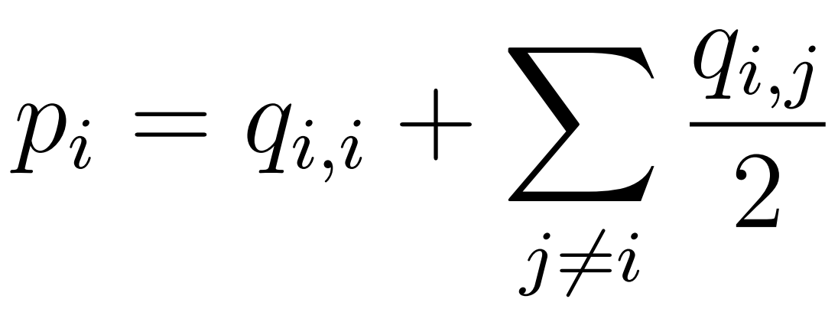




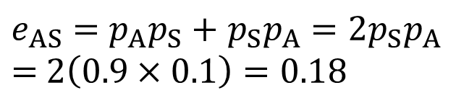
Example of BLOSUM Calculation
Step 3: count the observed and expected frequency of amino acid pairs.
$q_{AA}=36$/45 $=0.8$
$q_{AS}=9$/45 $=$ $0.2$
$$e_{AA}=p_{A}p_{A}=0.9×0.9= 0.81$$
$e_{AS}=$ $p_{A}p_{S}+$ $p_{S}p_{A}$ $=2p_{S}p_{A}$
$=$ $2\left(0.9×0.1\right)=0.18$
$$e_{SS}= p_{S}p_{S}=0.1×0.1=0.01$$

Slide 13
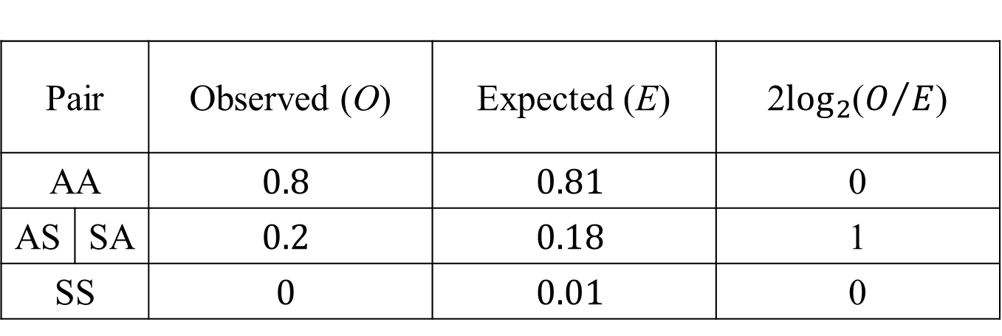
Example of BLOSUM Calculation
Step 4: calculate the log-odd ratio.
Pair |  | Observed (O) | Expected (E) | 2$\log_{2}$($O/E$)
AA |  | $$0.8$$ | $$0.81$$ | 0
AS | SA | $$0.2$$ | $$0.18$$ | 1
SS |  | $$0$$ | $$0.01$$ | 0

Slide 14
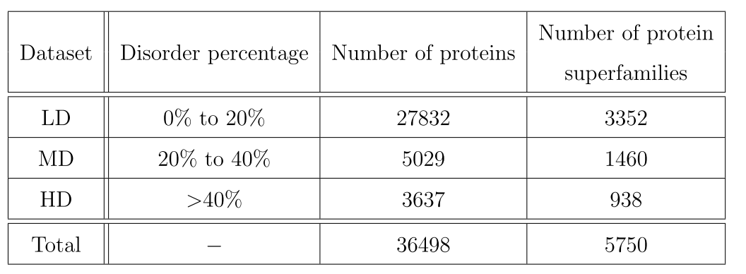
Motivation
Rakesh’s scoring matrices were computed using the Henikoff’s method (BLOSUM).
Disorder percentage is mean fraction of residues that was predicted to be disordered by the disordered protein predictors.
R. Trivedi and H. A. Nagarajaram, Amino acid substitution scoring matrices speciﬁc to intrinsically disordered regions in proteins, Scientiﬁc reports, Vol. 9, No. 1, pp. 1–12, 2019.
Notes:
綜上所述

Slide 15
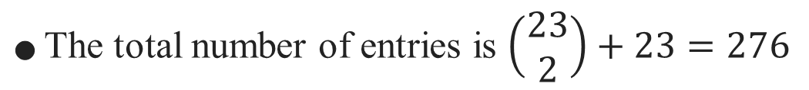
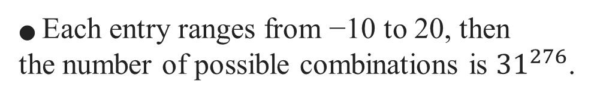
Motivation
Symmetric scoring matrix with 23 × 23:
● The total number of entries is $\left(\begin{matrix}23 \\ 2\end{matrix}\right)+23=276$
● Each entry ranges from −10 to 20, then
the number of possible combinations is ${31}^{276}$.
● We add the two scores for gap opening and gap extension.
Thus, the total number of entries is 278.
R. Trivedi and H. A. Nagarajaram, Amino acid substitution scoring matrices speciﬁc to intrinsically disordered regions in proteins, Scientiﬁc reports, Vol. 9, No. 1, pp. 1–12, 2019.
Notes:
綜上所述

Slide 16
Our Method
● The genetic algorithm — crossover
● The genetic algorithm — mutation
adopting harmony search method.
● In each generation, we generate 10 new chromosomes and weed out the poor chromosomes with bad fitness.

Slide 17
Our Method
Initial population
27 scoring matrices
(23 x 23 matrix)
Calculating fitness and
evaluation
Yes
Termination condition?
End
No
New population
Selection
Crossover
Mutation

Slide 18
Tournament Selection
2 20
1
2
3
4
5
•••
Fitness score of each scoring matrices in the population
23
24
25
26
27
Randomly selected for a tournament
4
9
9
Winner parent (passed on to crossover)

Slide 19
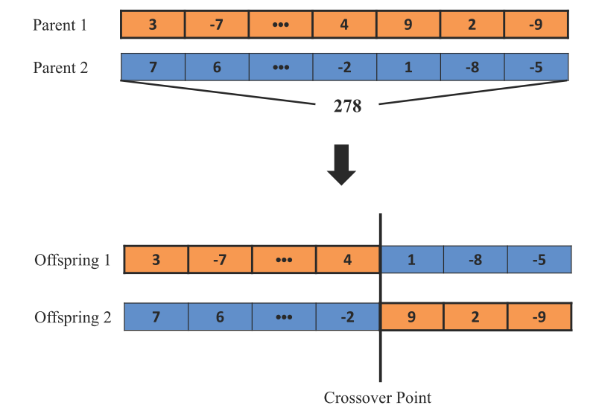
Crossover

Slide 20
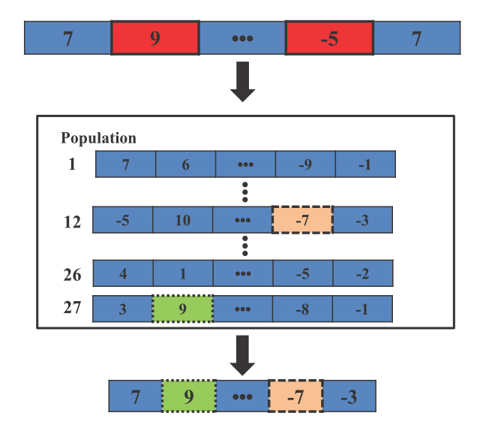
Mutation

Slide 21
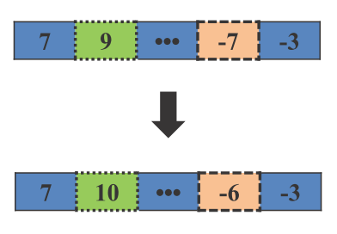
Mutation

Slide 22
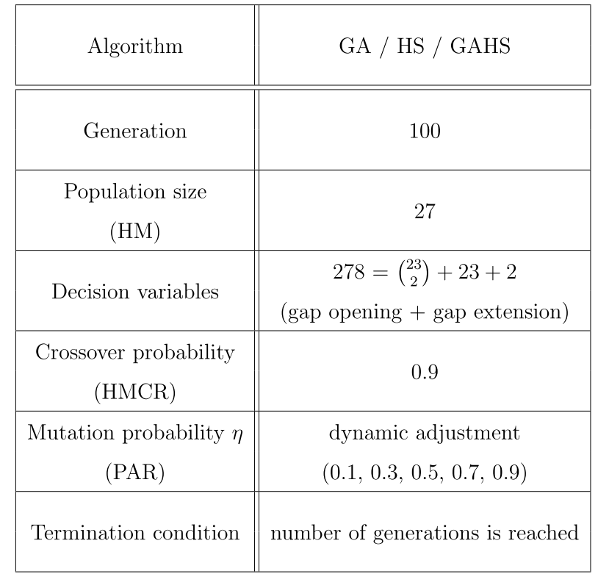
Parameter Settings

Slide 23
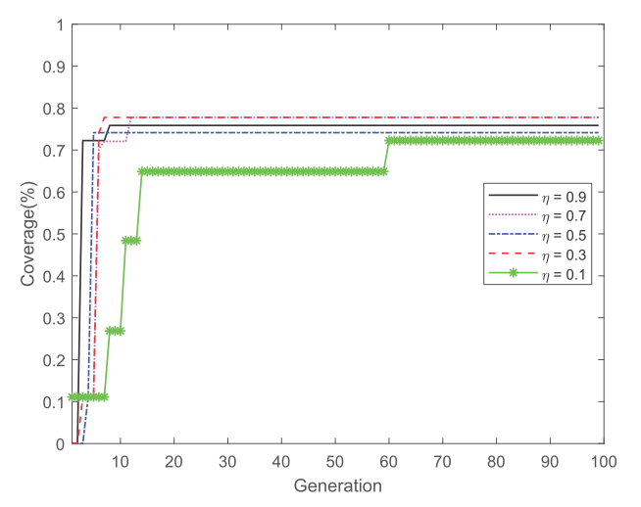
Parameter Settings
Dataset sample:
# EUMAT 36498 -> 1000
HD 3637 -> 100 MD 5029 -> 137 LD 27832 -> 763
Genetic algorithm

Slide 24
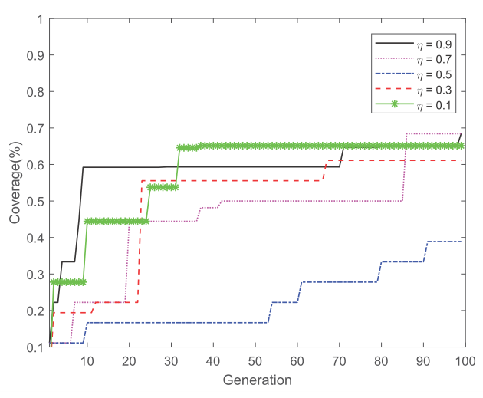
Parameter Settings
Harmony search
Notes:
一個多樣性的數值反而無法快速找到還不錯的解

Slide 25
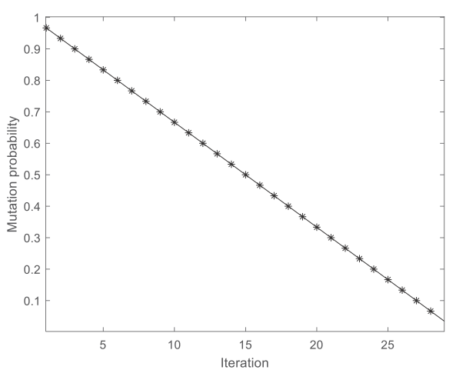
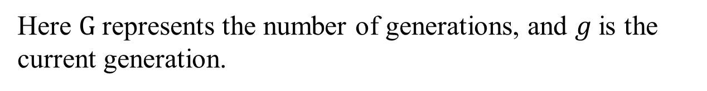
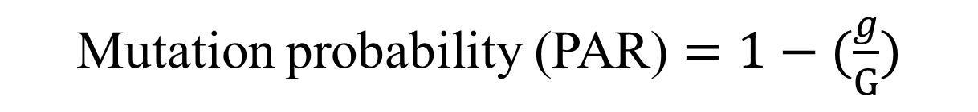
Dynamic Adjustment
Mutation probability (PAR) $=1−(\frac{g}{G})$
Here $G$ represents the number of generations, and $g$is the current generation.

Slide 26
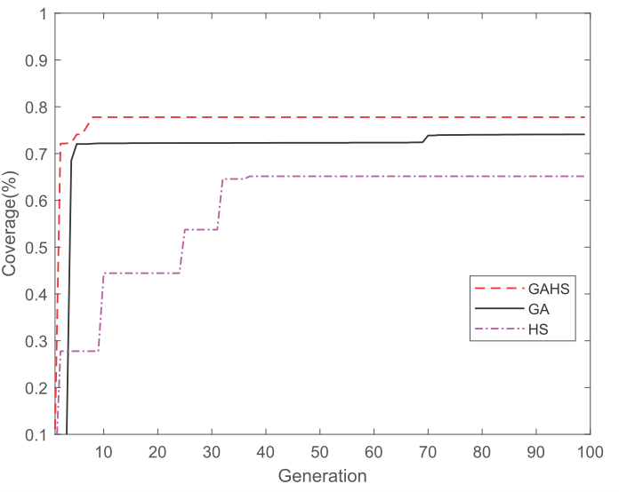
Parameter Settings

Slide 27
Experimental Results
10-fold cross validation for 5 times:
LD (27832) | MD (5029) | HD (3637 )
LD (2783) | MD (503) | HD (364)
LD (2783) | MD (503) | HD (364)
10
•••
LD (2785) | MD (502) | HD (361)

Slide 28
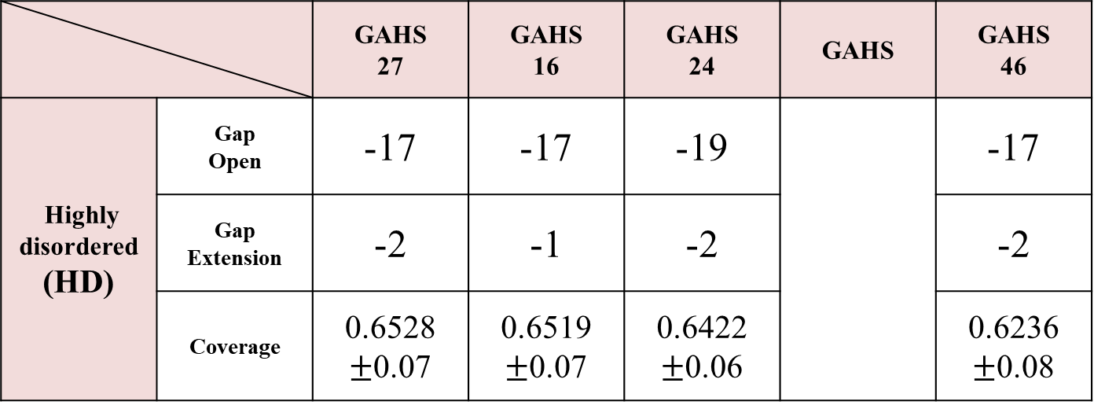
Experimental Results
10-fold cross validation for 5 times:
Matrix
 |  | GAHS 27 | GAHS 16 | GAHS 24 | GAHS | GAHS 46
Highly disordered (HD) | Gap Open | -17 | -17 | -19 |  | -17
 | Gap Extension | -2 | -1 | -2 |  | -2
 | Coverage | 0.6528 $±$0.07 | 0.6519 $±$0.07 | 0.6422 $±$0.06 |  | 0.6236 $±$0.08
Dataset
•••

Slide 29
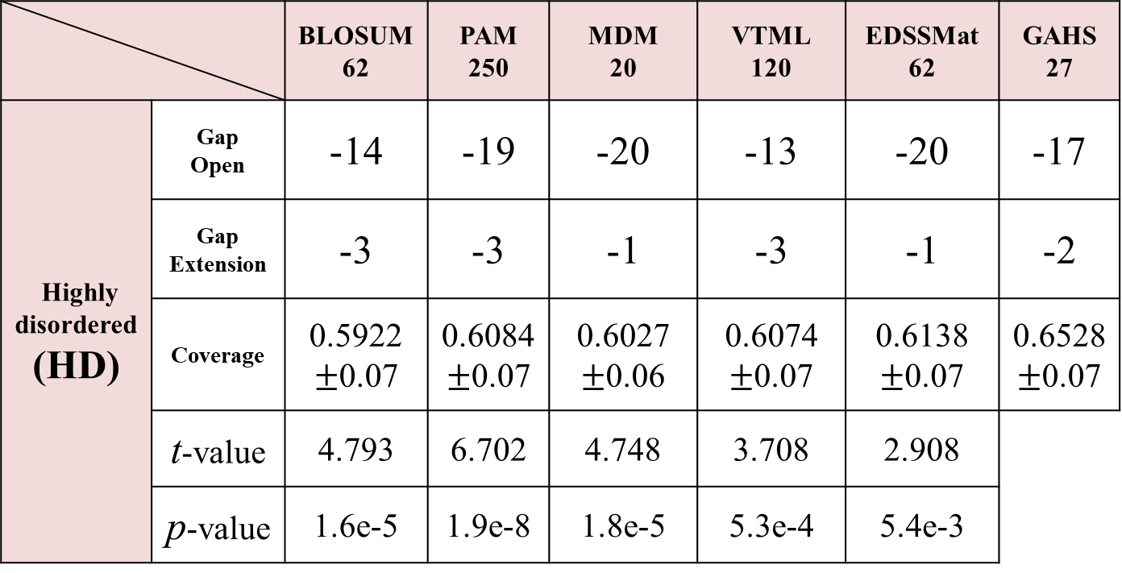
Experimental Results
10-fold cross validation for 5 times:
Matrix
 |  | BLOSUM62 | PAM 250 | MDM 20 | VTML 120 | EDSSMat 62 | GAHS 27
Highly disordered (HD) | Gap Open | -14 | -19 | -20 | -13 | -20 | -17
 | Gap Extension | -3 | -3 | -1 | -3 | -1 | -2
 | Coverage | 0.5922 $±$0.07 | 0.6084 $±$0.07 | 0.6027 $±$0.06 | 0.6074 $±$0.07 | 0.6138 $±$0.07 | 0.6528 $±$0.07
 | t-value | 4.793 | 6.702 | 4.748 | 3.708 | 2.908
 | p-value | 1.6e-5 | 1.9e-8 | 1.8e-5 | 5.3e-4 | 5.4e-3
Dataset
t-value > 2.0096 and p-value < 0.05 correspond to a 95% conﬁdence.

Slide 30
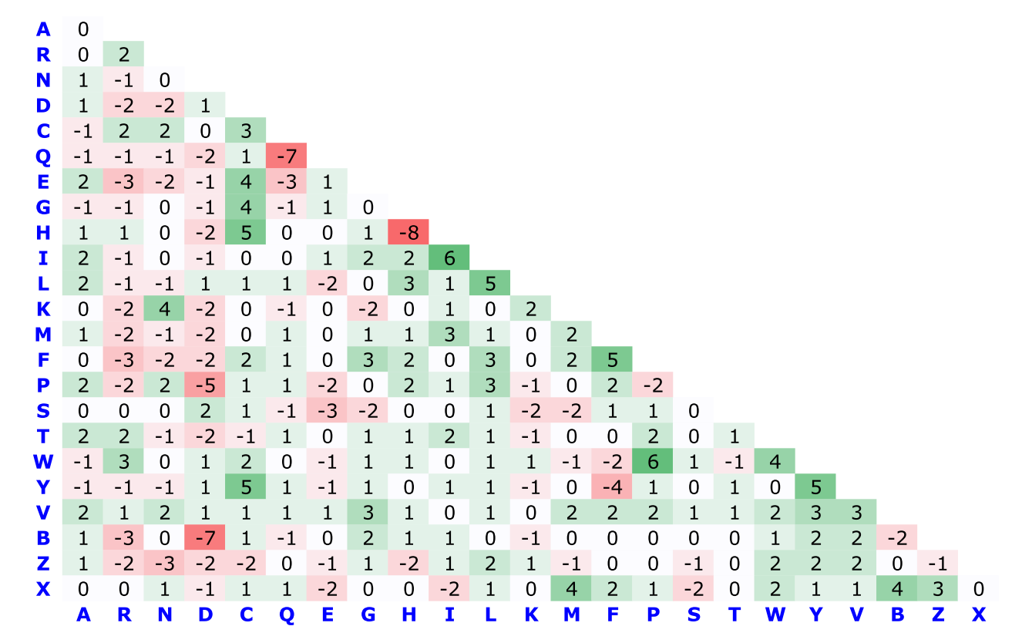
Experimental Results
Score diﬀerence(GAHS27 minus BLOSUM62):
Notes:
除了QQ，HH，
D列的mismatch對於disorder protein 來說需要更多的penalty
C列的mismatch就相較於disorder protein採取是提升一些分數

Slide 31
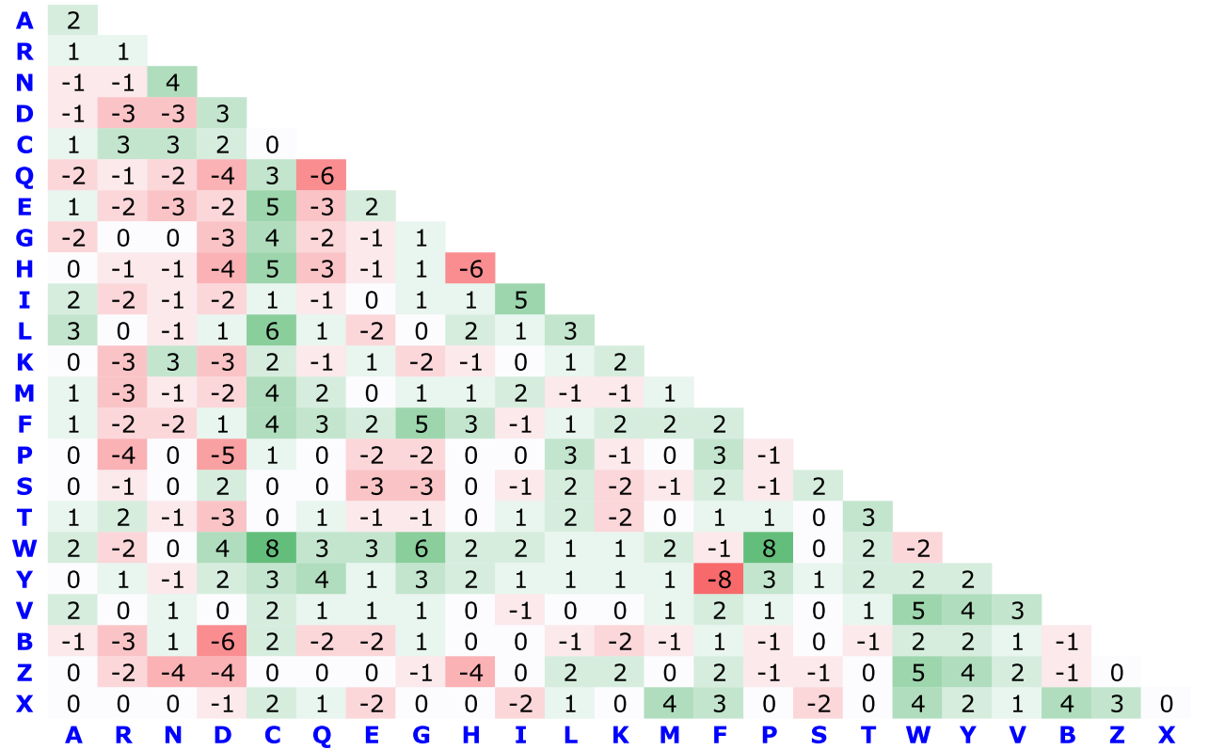
Experimental Results
Score diﬀerence(GAHS27 minus PAM250):
Notes:
D跟C和N根Q的mismatch變化又更大

Slide 32
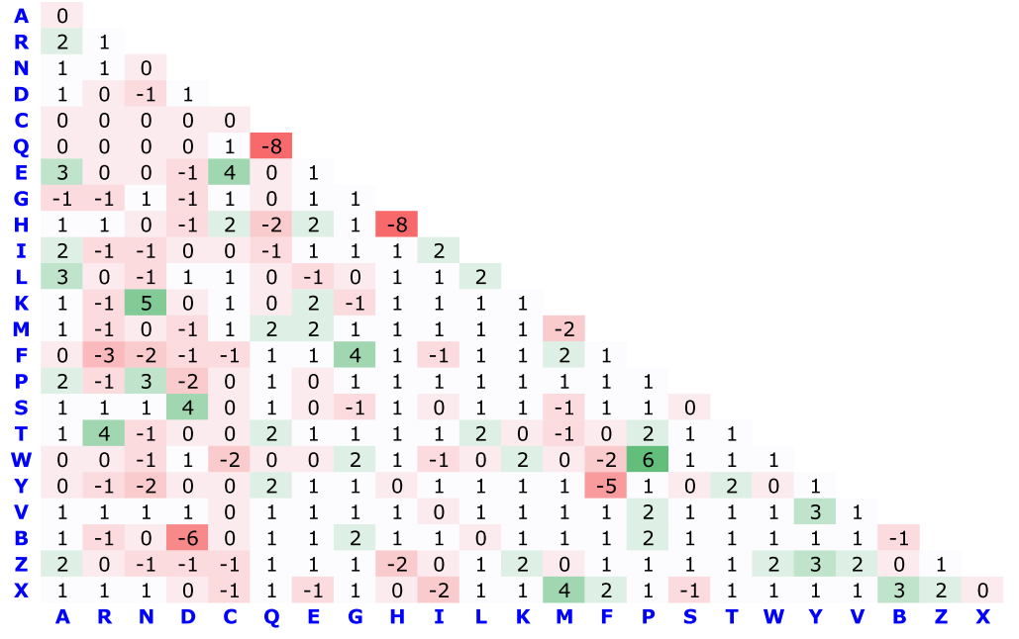
Experimental Results
Score diﬀerence(GAHS27 minus EDSSMAT62):

Slide 33
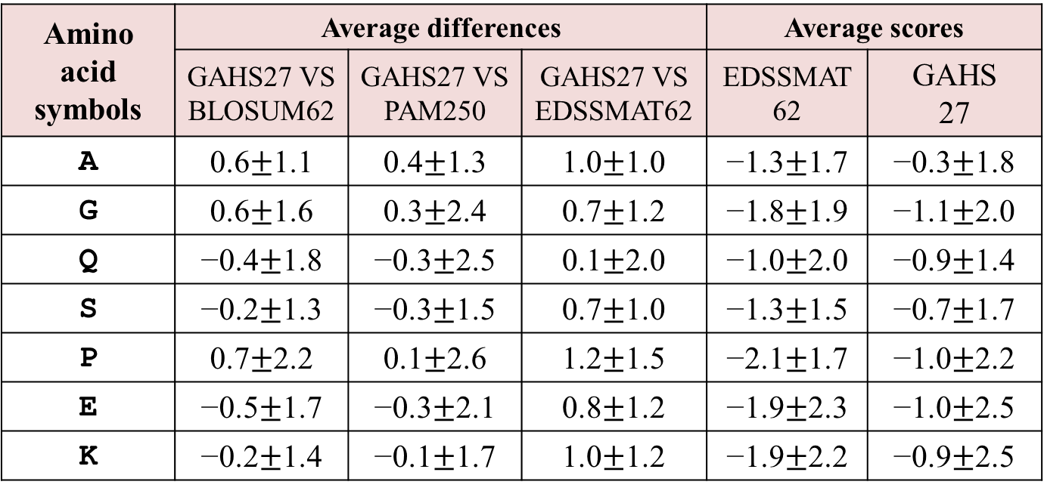
Experimental Results
(Disorder-promoting residues)
Amino acid symbols | Average differences |  |  | Average scores
 | GAHS27 VS BLOSUM62 | GAHS27 VS PAM250 | GAHS27 VS EDSSMAT62 | EDSSMAT62 | GAHS 27
A | 0.6$±$1.1 | 0.4$±$1.3 | 1.0$±$1.0 | −1.3$±$1.7 | −0.3$±$1.8
G | 0.6$±$1.6 | 0.3$±$2.4 | 0.7$±$1.2 | −1.8$±$1.9 | −1.1$±$2.0
Q | −0.4$±$1.8 | −0.3$±$2.5 | 0.1$±$2.0 | −1.0$±$2.0 | −0.9$±$1.4
S | −0.2$±$1.3 | −0.3$±$1.5 | 0.7$±$1.0 | −1.3$±$1.5 | −0.7$±$1.7
P | 0.7$±$2.2 | 0.1$±$2.6 | 1.2$±$1.5 | −2.1$±$1.7 | −1.0$±$2.2
E | −0.5$±$1.7 | −0.3$±$2.1 | 0.8$±$1.2 | −1.9$±$2.3 | −1.0$±$2.5
K | −0.2$±$1.4 | −0.1$±$1.7 | 1.0$±$1.2 | −1.9$±$2.2 | −0.9$±$2.5

Slide 34
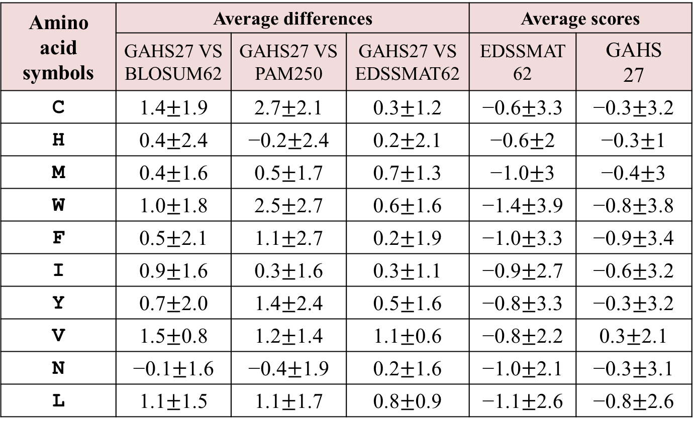
Experimental Results
(Order-promoting residues)
Amino acid symbols | Average differences |  |  | Average scores
 | GAHS27 VS BLOSUM62 | GAHS27 VS PAM250 | GAHS27 VS EDSSMAT62 | EDSSMAT62 | GAHS 27
C | 1.4$±$1.9 | 2.7$±$2.1 | 0.3$±$1.2 | −0.6$±$3.3 | −0.3$±$3.2
H | 0.4$±$2.4 | −0.2$±$2.4 | 0.2$±$2.1 | −0.6$±$2 | −0.3$±$1
M | 0.4$±$1.6 | 0.5$±$1.7 | 0.7$±$1.3 | −1.0$±$3 | −0.4$±$3
W | 1.0$±$1.8 | 2.5$±$2.7 | 0.6$±$1.6 | −1.4$±$3.9 | −0.8$±$3.8
F | 0.5$±$2.1 | 1.1$±$2.7 | 0.2$±$1.9 | −1.0$±$3.3 | −0.9$±$3.4
I | 0.9$±$1.6 | 0.3$±$1.6 | 0.3$±$1.1 | −0.9$±$2.7 | −0.6$±$3.2
Y | 0.7$±$2.0 | 1.4$±$2.4 | 0.5$±$1.6 | −0.8$±$3.3 | −0.3$±$3.2
V | 1.5$±$0.8 | 1.2$±$1.4 | 1.1$±$0.6 | −0.8$±$2.2 | 0.3$±$2.1
N | −0.1$±$1.6 | −0.4$±$1.9 | 0.2$±$1.6 | −1.0$±$2.1 | −0.3$±$3.1
L | 1.1$±$1.5 | 1.1$±$1.7 | 0.8$±$0.9 | −1.1$±$2.6 | −0.8$±$2.6
Notes:
V 遠房親緝

Slide 35
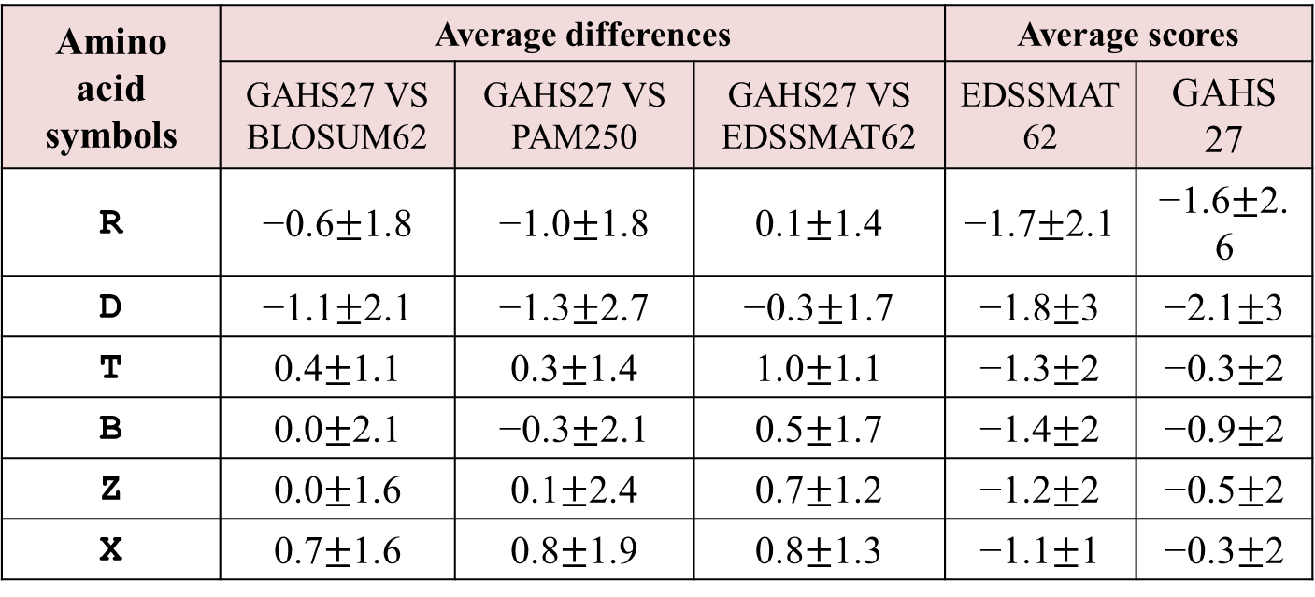
Experimental Results
Amino acid symbols | Average differences |  |  | Average scores
 | GAHS27 VS BLOSUM62 | GAHS27 VS PAM250 | GAHS27 VS EDSSMAT62 | EDSSMAT62 | GAHS 27
R | −0.6$±$1.8 | −1.0$±$1.8 | 0.1$±$1.4 | −1.7$±$2.1 | −1.6$±$2.6
D | −1.1$±$2.1 | −1.3$±$2.7 | −0.3$±$1.7 | −1.8$±$3 | −2.1$±$3
T | 0.4$±$1.1 | 0.3$±$1.4 | 1.0$±$1.1 | −1.3$±$2 | −0.3$±$2
B | 0.0$±$2.1 | −0.3$±$2.1 | 0.5$±$1.7 | −1.4$±$2 | −0.9$±$2
Z | 0.0$±$1.6 | 0.1$±$2.4 | 0.7$±$1.2 | −1.2$±$2 | −0.5$±$2
X | 0.7$±$1.6 | 0.8$±$1.9 | 0.8$±$1.3 | −1.1$±$1 | −0.3$±$2

Slide 36
Conclusion
We present a metaheuristic method for reconstructing the amino acid scoring matrix and compare it with the research of Rakesh et al.
As the experimental results show, the coverage calculated by our matrix is higher than other matrices in the HD dataset.
Most of the overall experiment time is spent on sequence comparison. In the future, It can be considered to decrease the time for sequence alignment.

Slide 37
Conclusion
We can try to adopt other metaheuristic algorithms, such as search economics, to modify the scores on some regions, instead of the entire scoring matrix.

Slide 38
Thanks for listening.

Slide 39
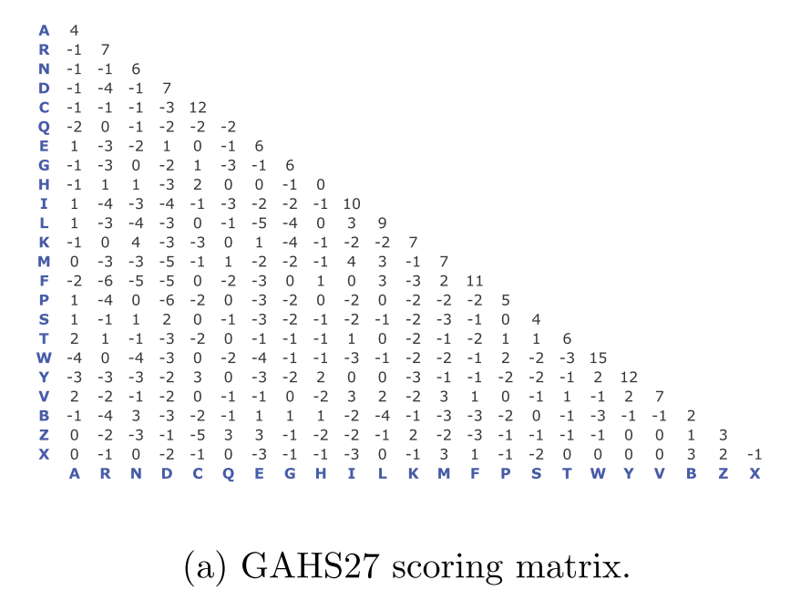

Slide 40
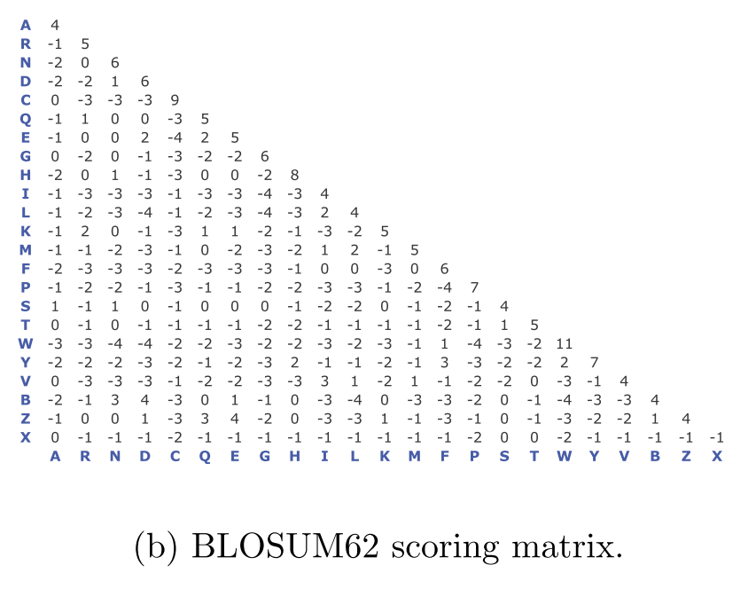

Slide 41
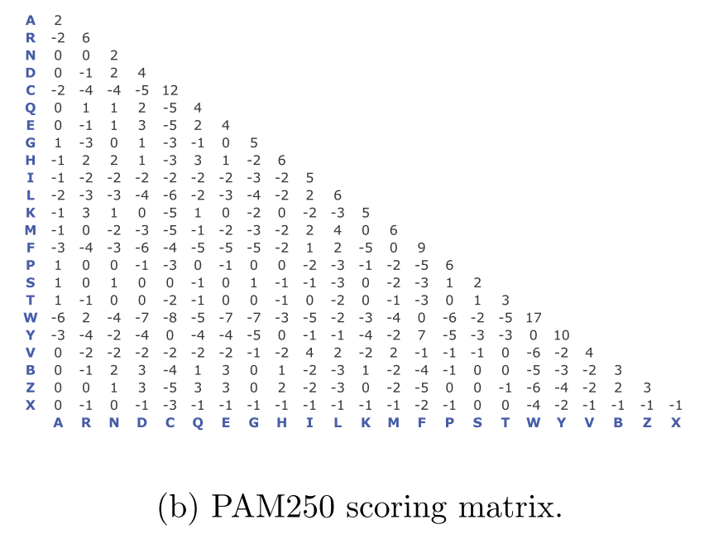

Slide 42
